Slide 1
Using Online Book Clubs to Engage Alumni in Lifelong Learning
January 26, 2021

Slide 2
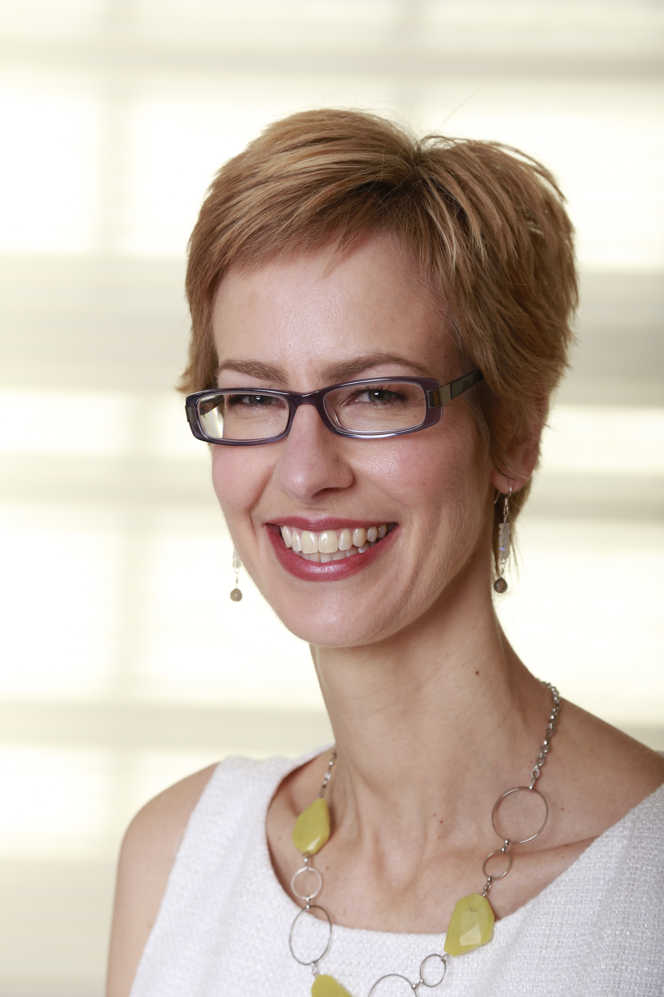
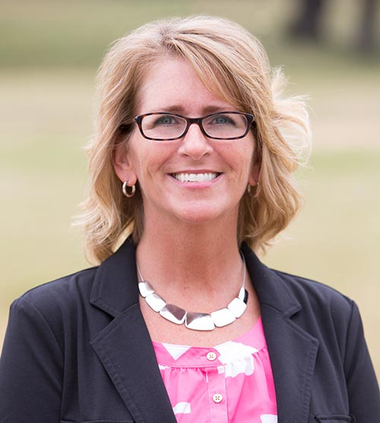
Introductions
Tracy Gagnier
Assistant Director of Alumni Relations
SUNY Geneseo
Mary Giles
Associate Director of Advancement Communications
Smith College

Slide 3
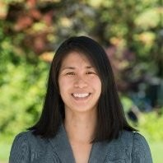
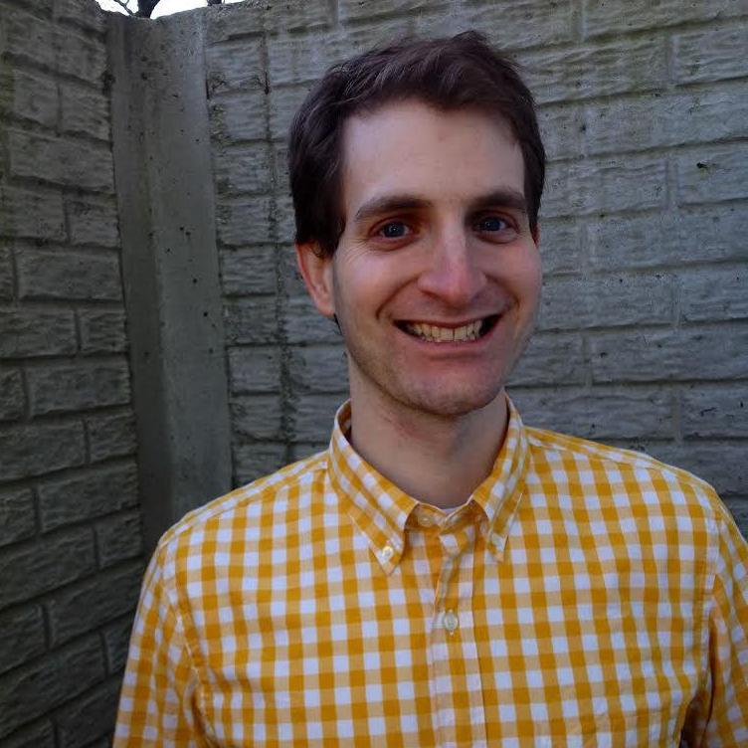
Introductions
Christine Lee
Associate Director Development and Alumni Engagement
University of British Columbia
Zach Rubin
Co-Founder and CEO
Professional Book Club Guru
Alumni Learning Consortium

Slide 4
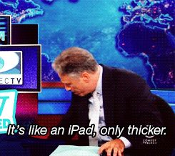
Agenda
What is an Online Book Club?
Why Use Book Clubs for Alumni Relations
Structuring an Online Book Club
Changes from COVID
Stories from the Field
Panel Q&A

Slide 5
What is an Online Book Club?
Similar to an In-Person Book Club:
Same group of people form a community
Reading the same book at the same time
Committed to continue reading books together
Difference is being based around an online forum
Global Access Asynchronous Scalable

Slide 6
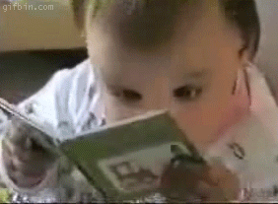
Why Use Book Clubs for Alumni Relations
Connects to your lifelong learning mission
60% of participants have never been engaged
1% to 5% participation rate
70% of participants are still engaged after a year
Can be customized to connect back to the institution

Slide 7
Structuring an Online Book Club
Online discussion community
Book selection
Scheduling
Marketing
Author/faculty involvement

Slide 8
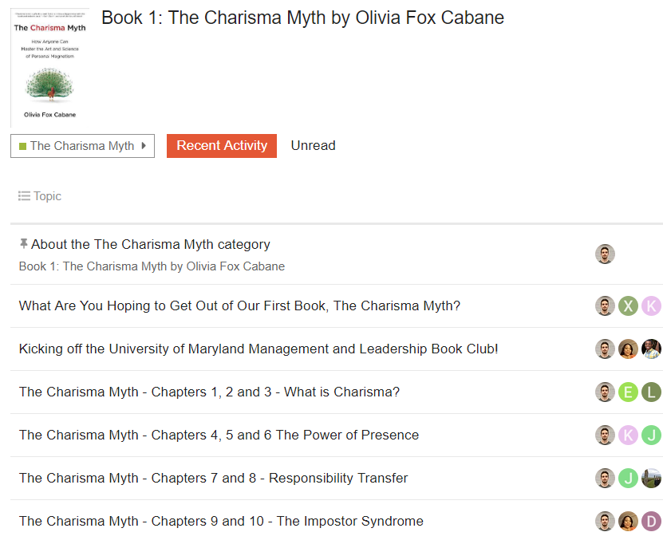
Online Discussion Community

Slide 9
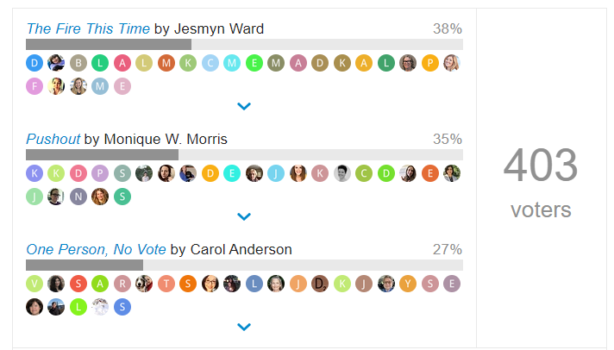
Book Selection
Best-sellers generally do best
Alumni and faculty authors
People enjoy many different kinds of books
Vote for selections
Choose books available as ebooks and audio books

Slide 10
Focus Area
One broad based book club works well
Focus on broad topics rather than demographic groups
Novels and Literature
Professional Development
Lifelong Learning
Avoid geographic focus

Slide 11
Scheduling
Reading Frequency
4 to 6 books per year
Announce books in advance so people have time to get their copy
Reading Schedule
Break reading down into sections
Share content and discussion questions throughout

Slide 12
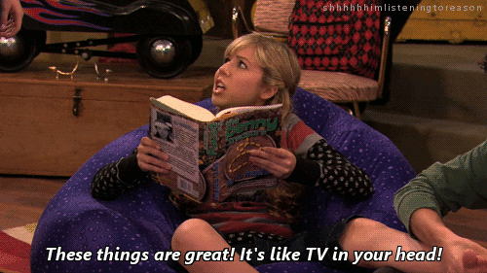
Marketing
Position program as a continuous community rather than one off events
Significant marketing push for the initial launch
Continue to market for the start of each book

Slide 13
Author/Faculty Involvement
Hold a Q&A call with participants
Record a short video posing questions
Have an “Ask Me Anything” thread in the online group
Tie book selection into an existing program

Slide 14
Changes from COVID
Idea works well in times of COVID
In-person meetups have moved online
More students participating
People like not having another online meeting but still being able to be in a book club

Slide 15
By the Numbers
School | Start | Participants | Emailable Alumni
SUNY Geneseo | Aug 2019 | 770 | 30,000
Smith College | June 2020 | 3,100 | 35,000
University of British Columbia | Sept 2019 | 1,940 | 150,000

Slide 16
Stories from the Field
Why an online book club was started
Feedback from alumni
Lessons learned
Advice for other schools

Slide 17
Questions and Your Stories
Tracy Gagnier SUNY Geneseo gagniert@geneseo.edu | Christine Lee University of British Columbia christine.lee@ubc.ca | Mary Giles Smith College mgiles@smith.edu | Zach Rubin PBC Guru zach@pbc.guru

