Slide 1

IT’S TIME TO GET OFF THE JOB SEARCH STRUGGLE BUS
Navigating the 2024 Job Market
www.letsbuildyouco.com | bevin@letsbuildyouco.com

Slide 2


AGENDA
My Background
Broken Job Search Process
10 Tips to Get Hired
Q&A

Slide 3
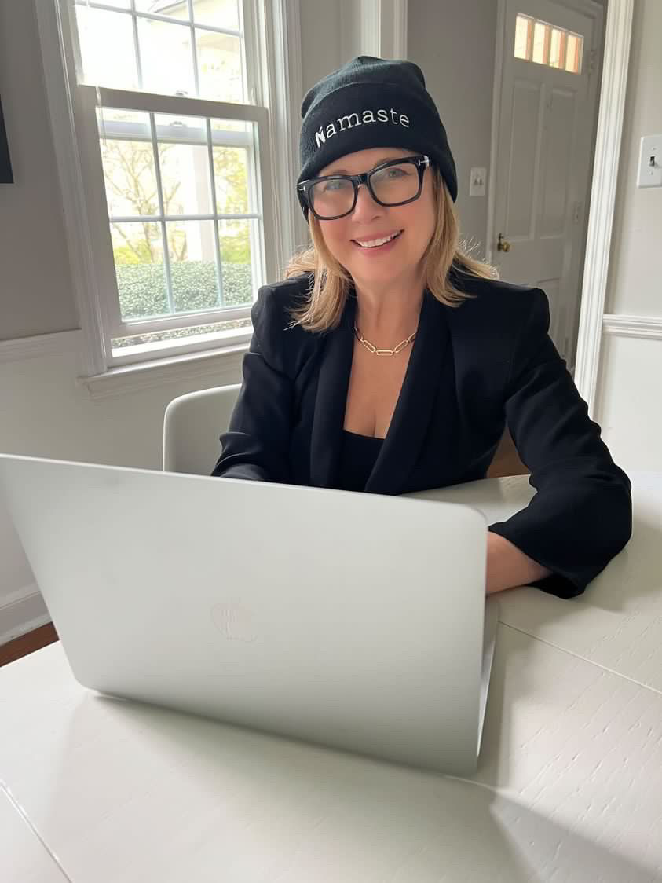
I'M BEVIN DOCKRAY
Certified Career Coach & Founder of
Let’s Build YOU
30+ Years Marketing Experience for Recognizable Companies & Nonprofits
Mom of 3 Young Adults
Miami Freshman Daughter
www.letsbuildyouco.com | bevin@letsbuildyouco.com

Slide 4

JOB HUNT: MISSION IMPOSSIBLE?
Are you sending out hundreds of resumes
and not getting interviews?
Are you being asked to do homework
assignments?
Are you being ghosted after multiple
interview rounds?
Do you think you’re facing age
discrimination or ageism?
Poll 1: What is your current professional situation?

Slide 5

AI TOOLS
Increased Competition
Applicant Misrepresentation
Recruitment Overload
35%
More applications submitted by jobseekers on LinkedIn in
2023 vs 2022
75%
Applicants don’t meet minimum job criteria
30%
Tech layoffs were in recruiting roles
85%
Applicants lie on their resumes
40%
Job seekers were ghosted by employers after multiple interviews, up from 30% in 2022
Source: Money magazine

Slide 6
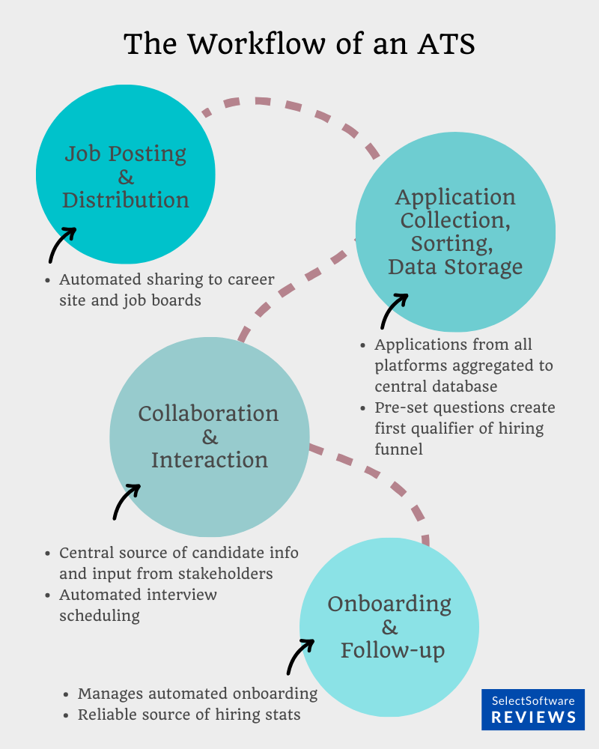

APPLICANT TRACKING SYSTEM
Used by 90% of Fortune 500 Companies
100+ ATS Systems
75%
Resumes Rejected
Before Making It
To a Recruiter
Forbes
Notes:
Software that automates steps in recruitment process
Knockout questions are straightforward, short answers, check boxes
Scan/Rank Candidates
Analyzes data in CV & cover letter
Select standout candidates
Tracking helps identify where candidates are in hiring process

Slide 7


HIRING MARATHON
Multiple Interview Rounds
Tests, Assessments, Projects
Poor Planning & Communication
Hiring Committees
Unprepared Interviewers
Hiring Criteria Disagreements
Notes:
While these can be useful to verify candidate skills and fit, they can also add complexity and length to the process.
Candidates may feel like they are doing unpaid work, and lose interest or motivation.

Slide 8

GHOST JOBS = FAKE JOBS
27%
Of 1,000 hiring managers left fake jobs posted for 4 months, never intending to fill them
50%
Of 1,000 hiring managers left fake jobs posted for so long to give impression that company was growing.
1/3
Of 1,000 hiring managers left fake jobs up to give appearance they were hiring to help boost morale internally.
Source: Wall Street Journal
Notes:
It's nearly impossible to determine which job posts are fake versus real.
Be wary of jobs that have been reposted, especially multiple times.
Check company website to see if job posted in Career section.
Try to develop a connection in the company to ask if the job post is real.

Slide 9
WORKPLACE AGEISM
25%
Workers age 55+
in workforce
67%
Workers 40 - 65 want to keep
working after turning 66
Prevalence of Workplace Age Discrimination
60%
55+ employees have seen or experienced workplace age discrimination
95%
55+ employees say workplace ageism is common
75%
55+ employees say age
is an obstacle to finding a job
Source: AARP

Slide 10

NEGATIVE MINDSET

Slide 11






UNPRODUCTIVE JOB SEARCH STRATEGY
  68%
01
03
  250
Recruiters review your resume
in less than 2 minutes
Average # of applicants for a single corporate job.
  6 seconds
02
04
  3%
Amount of time to determine if candidate is the right fit
Online applicants
get an interview.
Source: Forbes
Notes:
Traditional job search methods don't work

Slide 12

JOB QUEST
ENDGAME ACHIEVED
Understand how the job search
game is played.
Poll 2: What is the most challenging part of job searching?

Slide 13


01
KNOW WHO YOU ARE &
WHAT YOU WANT TO DO
Create Your Personal Brand Statement

Slide 14
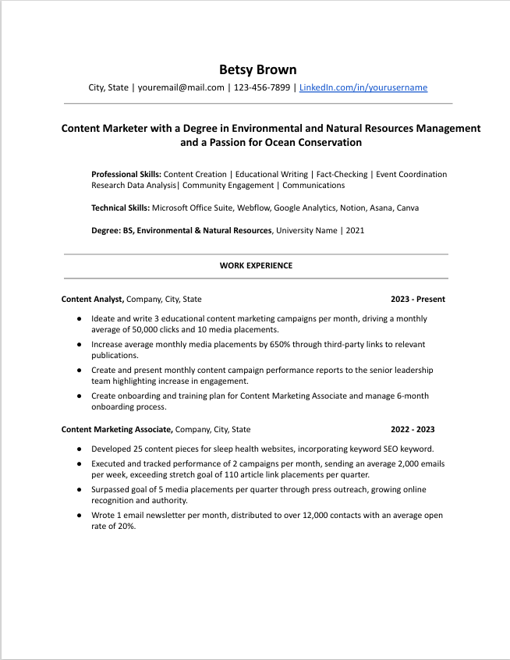
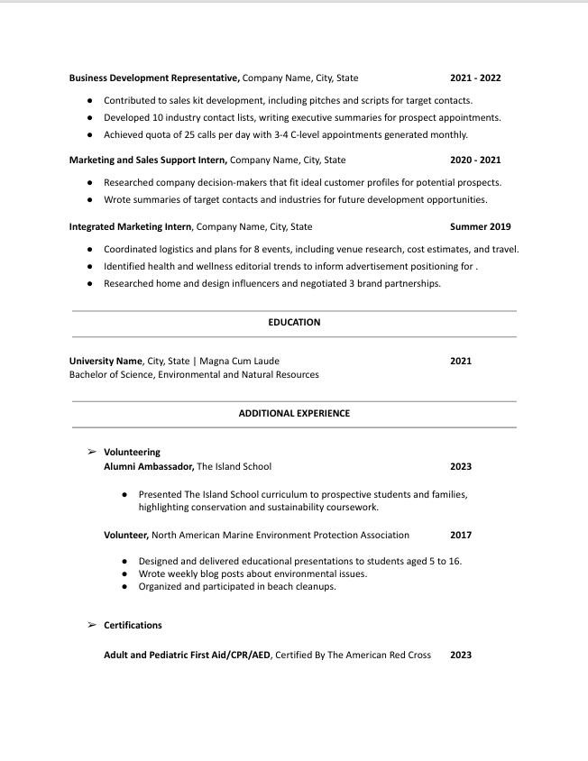
02
A 6-SECOND QUICK-READ RESUME
Notes:
Your resume can get you the interview but not the job.
It's your ticket to entry and is the first impression you have to make on employers.
No fancy graphics, pictures, charts or graphs
Enough white space & margins to break up the text
2 - 3 word statement as headline
Hard skills & quantifiable results
Key word relevance
No subjective language
3 - 5 bullet points per role

Slide 15
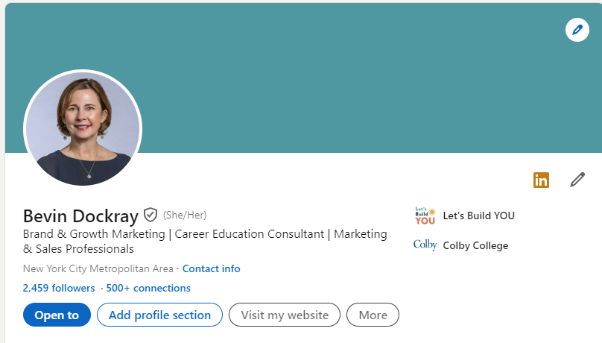
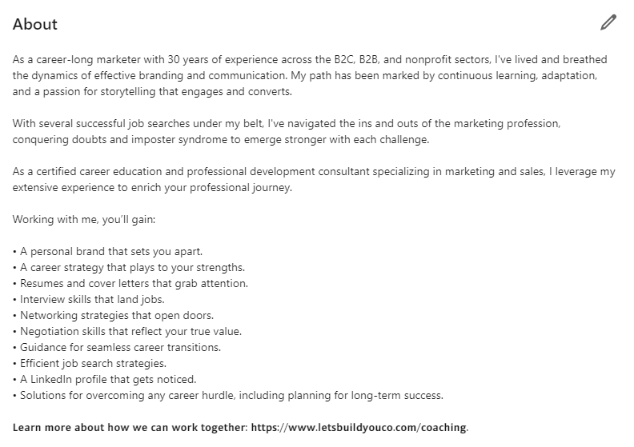
03
A SEARCHABLE LINKEDIN PROFILE
Skill-Based Headline | Professional Photo | Personalized LinkedIn URL | Value Statement
Skills | SEO Key Words | Quantifiable Accomplishments
Notes:
77% Recruiters Rely on LinkedIn

Slide 16
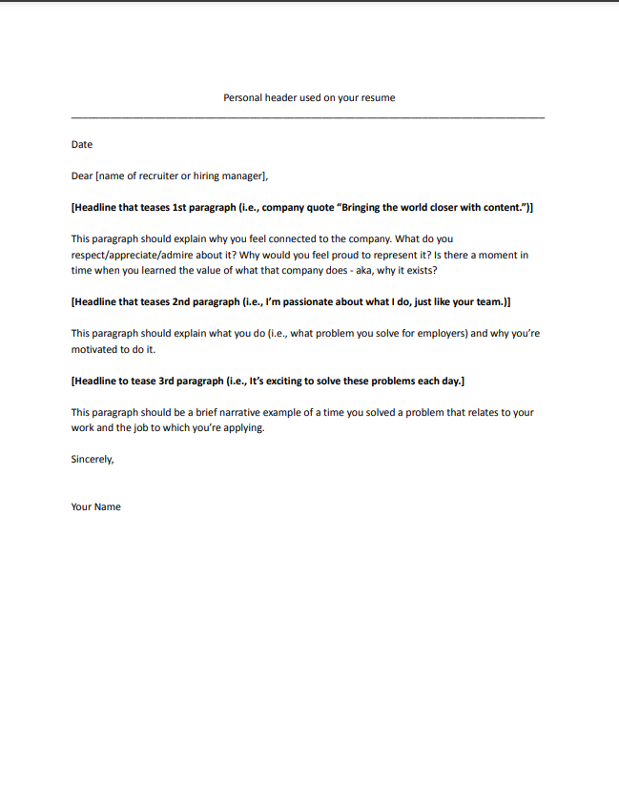
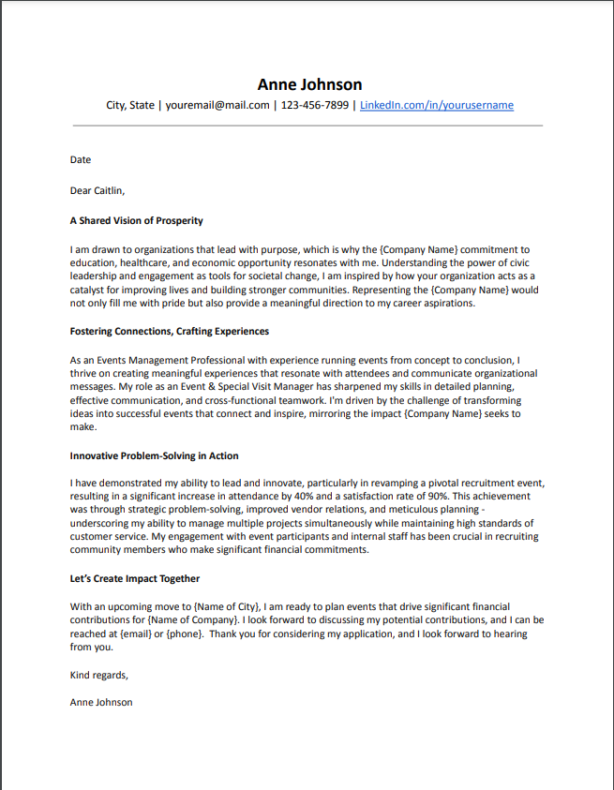

04
CONNECTION COVER LETTER
Grab them from the beginning.
Make it relevant to THEM.
Inspire with a personalized message.
Share a story that ties you to the job.
Tell them why you want the job.
Demonstrate why you’re a good fit.
Notes:
Grab them from the beginning.
Make it relevant to THEM.
Inspire with a personalized message.
Share a story that ties you to the job.
Tell them why you want the job.
Demonstrate why you’re a good fit.

Slide 17

05
BECOME A JOB SHOPPER
50%
Chance of getting interview with employee referral
60%
Jobs found through
networking
30% - 50%
Roles filled with
employee referral
Interview Bucket List | Connection Story | Authentic Connections | Hidden Job Market
Poll 3: How do you primarily discover job openings?
Source: Forbes
Source: Forbes
Notes:
Become intentional with job search
Get an "in" once you start meeting with people

Slide 18

06
ACT LIKE A SALESPERSON
Showcase the 10% of Yourself That’s
100% Qualified for the Job
David Fano, Founder & CEO, Teal

Slide 19
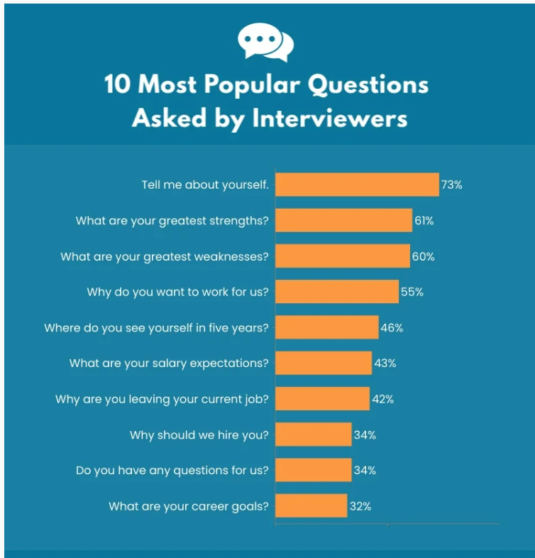
07
INTERVIEW PREP
45%
Recruiters will take only 90 seconds to decide if a candidate will go to next interview round.
Forbes
70%
Large companies are using Evidence-Based Hiring via asynchronous video interviews.
S2Verify
40%
Companies will check candidate social media accounts during interview process.
Legal Jobs
Notes:
This is where you stand out from the competition
This is the place where people blow it the most
Personality, Aptitude and Experience
If you don’t understand how to answer behavioral questions, you’ll end up giving too little or too much information
Show them how you can save or make them enough money to justify hiring you
Succinct answers that tell stories about how you can help solve their problems.
Evidenced-Based Hiring is the new normal today
To combat misrepresentation, companies using asynchronous video interviews, asking applicants to pre-record responses for authenticity.
You’re going to get asked questions like:
Tell me about a time you did this
Show me when you’ve been able to do that

Slide 20

08
PROFESSIONAL DEVELOPMENT
58%
Employees improve job satisfaction through professional development
97%
Enterprise decision-makers believe pandemic accelerated workplace digital transformation
Notes:
It's not age discrimination - it's experience discrimination
Selling yourself hard - you're the jack of all trades
BMW for the price of a Honda
Job search and interview game has to be so on point
Job search is a pyramid
Temporary productive discomfort
Learn new skills for the place where you are in your journey

Slide 21

09
KNOW YOUR WORTH
78%
Employers Anticipate Salary Negotiations
40%
Applicants Don’t
Negotiate Salary
58%
Millennials Are Not
Negotiating Salary
Skill Set Analysis | Trend Research | Articulate with Confidence

Slide 22
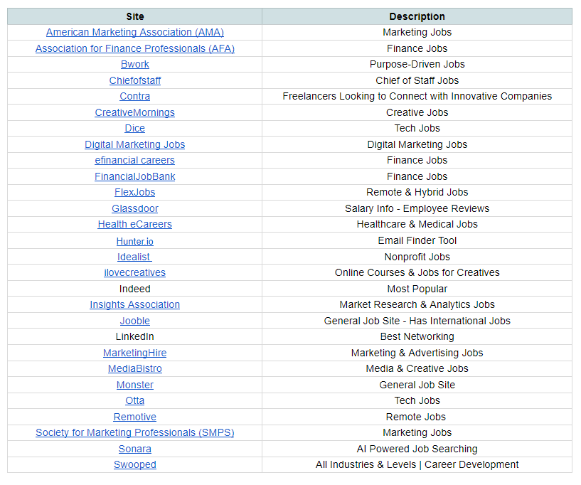
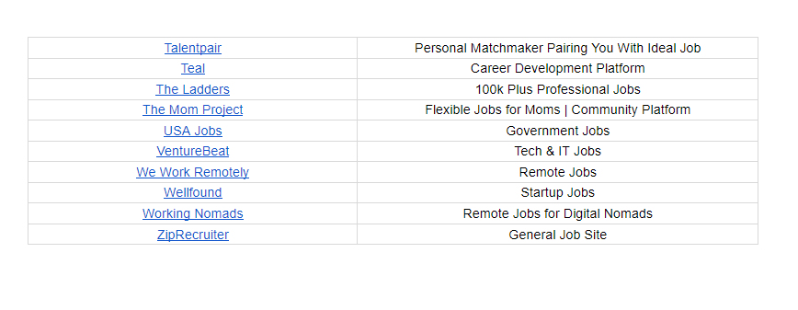
10
JOB SEARCH RESOURCES

