Slide 1
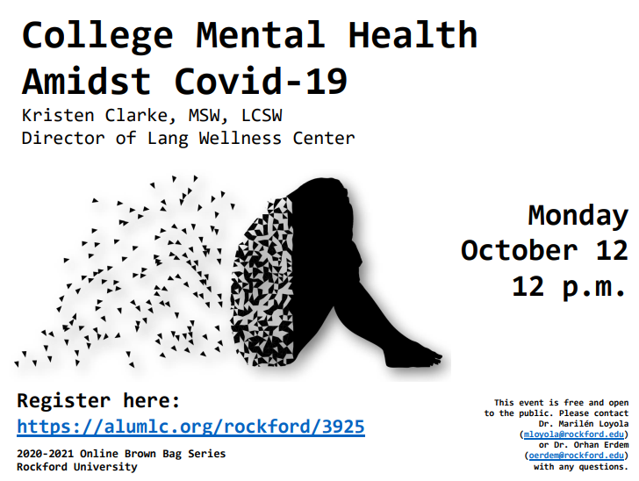

Slide 2
Pre Covid-19 College Mental Health Data
Mental Health is a major issue on college and university campuses.
Increases in depression, anxiety, eating disorders, suicidality, and other issues in student populations over the past 10 years.
About one-third of students meet criteria for a clinically significant mental health problem.
“A 2019 survey by the American Council on Education (ACE) found that 82 percent of college presidents agreed or strongly agreed that faculty on their campus were spending more time addressing student mental health concerns than three years ago.”
Active Minds: Creating a Culture of Caring

Slide 3
Why the Increase?
Increased awareness of mental health
Less of a stigma – more comfortable talking about personal problems
More readily available resources
Mandated trainings
Higher academic expectations on children and teenagers
Social Media pressures

Slide 4
Spring and Summer 2020 Data
“The percentage of respondents who reported having seriously considered suicide in the 30 days before completing the survey (June 24-30, 2020) was significantly higher among respondents aged 18–24 years (25.5%)” – CDC report
Active Minds March – May 2020 Survey
80% of college students said Covid had a negative effect on their mental health
Two-thirds of students report their financial situation has become more stressful.
Students report that their campuses have generally been supportive, especially professors.
Sixty percent of students indicate that the pandemic has made it more difficult to access mental health care.

Slide 5
Spring and Summer 2020 Data
TimelyMD Survey May 29 to June 3, 2020
The top three causes of stress and anxiety of students related to academics:
72% feel uncertainty about the future of their education
61% fear falling behind in their coursework
60% have experienced struggles with remote learning
50% worried about future career and job prospects
49% had fears about their health and/or the health of loved ones

Slide 6
Spring/Summer Concerns
Isolation feelings due to stay at home orders
Difficult transition to remote learning
Financial issues
I can’t do online again.
Grief
All the unknowns
Will we go back to school?
When will we know?
What’s it going to be like?
Are people going to follow the guidelines?
Will I be exposed?/What if I get Covid?
Will my roommate take precautions?

Slide 7
Active Minds September 2020 Survey Results

Slide 8
Active Minds September 2020 Survey Results

Slide 9
Active Minds September 2020 Survey Results

Slide 10
Active Minds September 2020 Survey Results

Slide 11
Active Minds September 2020 Survey Results

Slide 12
August and September Concerns
People aren’t wearing their masks or taking any of this seriously.
When are we going to be sent home?
Worried about parents getting sick
Every Day is Different – no set schedule

Slide 13
Enter October
My experiences in October
Highest month for mental health inpatient hospitalizations
Highest month for runaway and lockout calls
Students new to counseling reach out
Professors start having concerns for students and refer to Lang
October 2020
Positivity rate in our region increases
No Fall Break
Students feel like there are more assignments for classes
Changes to the syllabus
Students feel exhausted
We might actually make it to Thanksgiving!

Slide 14
How to Help https://www.activeminds.org/wp-content/uploads/2020/04/Faculty-Resource_Creating-a-Culture-of-Caring.pdf?sm_guid=MzMyNTg2fDIyMjg1MDU1fC0xfGxhdXJhQGFjdGl2ZW1pbmRzLm9yZ3wyNjM3MzM3fHwwfDB8NzAyMTQ2NDV8OTUxfDB8MHx8MzAwNjcy0

Slide 15
Warning Signs

Slide 16
Warning Signs
Straight A Students
Always Early to Class
Students needing repeated reassurance
Very full daily schedule
Color Coded Planners
These are already very anxious students and the above are their coping skills. Some of these students are not ok right now!

Slide 17
Warning Signs
Talk of
feeling trapped
unbearable pain
being a burden to others
seeking revenge
Increase use of drugs or alcohol
Acting Anxious or Agitated
Reckless behaviors
Displaying extreme mood swings
Fear and worry of own health and health of loved ones
Changes in sleep and appetite
Difficulty concentrating
Worsening of chronic health issues
Worsening of mental health issues
Talk of death or wanting to kill one’s self

Slide 18
How to Help

Slide 19
How to Help

Slide 20
How to Help
Normalize – give reassurance that it’s ok to feel this way right now.
Reach out to the students
Set up a 1:1
Actively Listen
Don’t interrupt
Keep good eye contact
Nod along as the person is talking
Mirror the speaker
Paraphrase what you are hearing
Don’t say, “Well, at least…” they aren’t looking for a silver lining

Slide 21
How to Help
Validate the person’s feelings
“That makes sense.”
“I think you have every right to feel that way.”
Help to label the feelings
“It sounds like you are really overwhelmed.”
“You seem like you’re describing grief.”
Be accepting and non-judgmental
Empathy builds connection – Brene Brown - www.youtube.com/watch?v=1Evwgu369Jw

Slide 22
How to Help
Thank the student for opening up
Ask who the student usually talks to for support
Ask if talking to that person is helpful
Find out what the student usually does for self-care or relaxation
Exercise
Meditating/Prayer
Reading
Grounding techniques- focus on the present moment
If the student isn’t doing any of this – encourage it
Refer to counseling if you think it’s appropriate

Slide 23
How to Help
Unbearable Pain
Hopeless feelings
Nothing seems to help
There are times in our lives when we will truly struggle
It is ok to lower expectations and just get through
Try to draw from past experiences that were a struggle – This may be the hardest point so far in a person’s life.
Buddhist Teaching – The Two Arrows
1st = actual pain and 2nd = suffering thoughts
Surrender - FROG – Fully Rely on God – really tap into your spiritual life

Slide 24
How to Help https://www.mentalhealthfirstaid.org/2020/03/how-to-care-for-yourself-while-practicing-physical-distancing/

Slide 25
Prepare for Upcoming Stress
More anxiety as we approach the election and after
Major assignments all due at the same time
“Should I go home at Thanksgiving or self-quarantine before I go home to my family?”
“My family is having a big Thanksgiving and I’m expected to go. I’m not comfortable with that.”
Flu and Covid will be complicated to navigate – here come the unknowns again
“Will we be here in January?”

Slide 26
Resources
https://www.acenet.edu/Documents/Mental-Health-Higher-Education-Covid-19.pdf
https://www.sprc.org/resources-programs/treating-suicidal-patients-during-covid-19
https://www.sprc.org/resources-programs
https://www.sprc.org/effective-prevention/comprehensive-approach
https://www.sprc.org/about-suicide/warning-signs
https://www.sprc.org/about-suicide/risk-protective-factors
https://www.mentalhealthfirstaid.org/2020/03/how-to-help-someone-with-anxiety-or-depression-during-covid-19/
https://www.mentalhealthfirstaid.org/2020/03/how-do-i-know-someone-is-experiencing-anxiety-or-depression/
https://www.mentalhealthfirstaid.org/2020/03/how-to-care-for-yourself-while-practicing-physical-distancing/
https://www.mentalhealthfirstaid.org/2020/04/how-to-manage-your-mental-health-when-feeling-stressed-during-covid-19/
https://www.acha.org/documents/ncha/Healthy_Minds_NCHA_COVID_Survey_Report_FINAL.pdf
https://www.npr.org/sections/health-shots/2020/03/26/820304899/coronavirus-has-upended-our-world-its-ok-to-grieve
https://www.apa.org/news/apa/2020/04/grief-covid-19
https://www.jedfoundation.org/covid-19-resource-guide-for-higher-education-professionals/
https://www.activeminds.org/wp-content/uploads/2020/04/Faculty-Resource_Creating-a-Culture-of-Caring.pdf?sm_guid=MzMyNTg2fDIyMjg1MDU1fC0xfGxhdXJhQGFjdGl2ZW1pbmRzLm9yZ3wyNjM3MzM3fHwwfDB8NzAyMTQ2NDV8OTUxfDB8MHx8MzAwNjcy0
https://www.cdc.gov/mmwr/volumes/69/wr/mm6932a1.htm?s_cid=mm6932a1_w
https://www.timely.md/college-students-mental-health-continues-to-suffer-from-covid-19-new-survey-by-timelymd-finds/

Slide 27
Discussion

