Slide 1
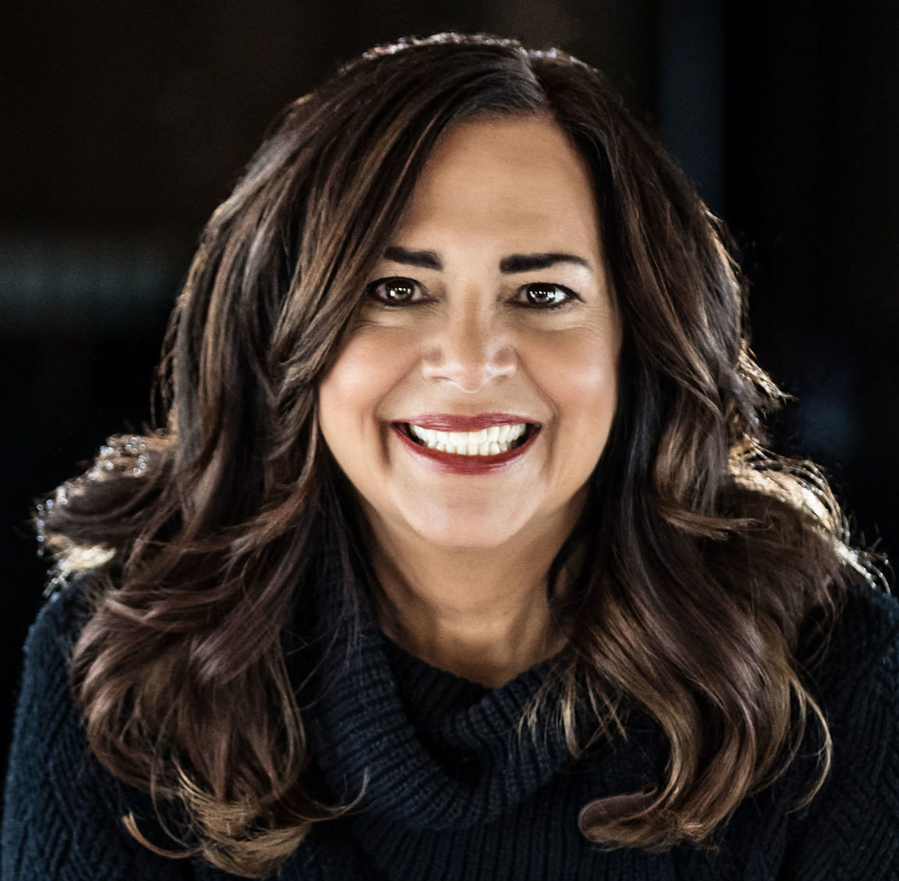
The Most Powerful You:
How to Recognize and Close Your Power Gaps And Rise To Your Highest Potential
Close Your Power Gaps
November 1, 2023
Presented by: KATHY CAPRINO, M.A. - INTERNATIONAL CAREER AND LEADERSHIP COACH, SENIOR FORBES CONTRIBUTOR, AUTHOR AND HOST OF THE FINDING BRAVE PODCAST
© 2023 Kathy Caprino

Slide 2
Overview
WHAT WE'LL COVER
What Is Power and Why We Need It
The 7 Damaging Power and Confidence Gaps That Keep Women From Thriving In Their Lives and Work
7 Brave Pathways To Career Bliss
What To Do First, To Shift What Is Possible
2
Close Your Power Gaps • Kathy Caprino

Slide 3
Why hundreds of professionals around the globe have come for career help…
THEY FEEL UNABLE TO WORK, LEAD,
COMMUNICATE AND GROW IN THE WAY THEY WANT TO:
Don't feel recognized or valued
Feel they're meant for something bigger or better
Aren't advancing or receiving compensation they deserve
Not doing work that feels right, good or purposeful
Feeling there is too much struggle
They want more, different and better
Overall, they don't feel able to reach their highest, most joyful potential
3
Close Your Power Gaps and Rise• Kathy Caprino

Slide 4
What is missing MOST?
4
BRAVERY – to recognize and face head on what isn’t working and take the accountability to change it
POWER – To act with influence and impact on one’s own behalf, to advocate for yourself and others and become the true author and leader of your life.
Close Your Power Gaps • Kathy Caprino
© 2023 Kathy Caprino

Slide 5
Why we need power
POWER IS AN ESSENTIAL COMPONENT TO A THRILLING AND IMPACTFUL CAREER, BUT MANY PEOPLE (OFTEN WOMEN) SHUN IT.
Power TO, not power OVER
Ability to accomplish, create and manifest
Strength to become a force for good
Influence to make an impact and difference
Authority to lead and work as you wish
Self-trust to share your ideas and visions
Power doesn’t have to be:
Harsh - Critical - Aggressive - Angry - Hurtful - Abusive
5

Slide 6
What It Feels Like To Be a Brave & Powerful Professional
ENGAGE in meaningful, rewarding work
EARN the respect, recognition (and money) you deserve
LEAD well and LEVERAGE your natural talents and gifts in service of others
BUILD heart-connected relationships that are healthy, beneficial, and enriching
UPLIFT others as you rise
© 2023 Kathy Caprino

Slide 7
THE 7 DAMAGING POWER GAPS that keep people from reaching their highest, most thrilling potential and impact in their studies, work, careers, relationships, and personal lives
7

Slide 8
98% OF THE 1,400+ WOMEN SURVEYED (and 90% OF THE MEN) ARE EXPERIENCING AT LEAST ONE OF THESE 7 GAPS
My latest survey revealed:
75% are having 3 or more gaps at the same time
When you have these gaps, you cannot thrive to the highest degree
Close Your Power Gaps • Kathy Caprino
© 2023 Kathy Caprino
8

Slide 9
THE TOP 7 POWER
GAPS that women experience
#1
Not Recognizing Your Special Talents, Abilities and Achievements (T=63%; Y=83%)
#2
Communicating From Fear, Not Strength (70%)
#3
Reluctance To Ask for What You Deserve (T=77%; Y=85%)
#4
Isolating from Influential Support (T=71%; Y=83%)
#5
Acquiescing Instead of saying "STOP!"
(T=48%; Y=57%)
#6
Losing Sight of Your Thrilling Dream (76%)
#7
Allowing Past Trauma to Define You (62%)
T = Total Respondents who indicate having the gap; Y= Young adults ages 18-24 who indicate having the gap
© 2023 Kathy Caprino
9

Slide 10
WHY STUCK?
IT'S ACTION THAT
CHANGES OUR LIVES, NOT THOUGHT.
Why do so many struggle to make the changes they long for? Because insight isn’t enough.
It’s brave, empowered action that changes our lives. And it's consistent, committed action that's needed.
10

Slide 11
16
The Framework For Change
7 BRAVE PATHWAYS TO CAREER BLISS
Close Your Power Gaps • Kathy Caprino
11

Slide 12
CLOSE YOUR POWER GAPS WITH 7
BRAVERY-BOOSTING PATHS:
Brave Sight Brave Speak Brave Ask
Brave Connection Brave Challenge Brave Service
Brave Healing
© 2023 Kathy Caprino
12

Slide 13
The 7 Brave Pathways significantly expand our experience of:
Self-mastery
Confidence and self-trust
Executive Presence
Communication Strength
Leadership and Vision
Relational Connection
Joy, Fulfillment & Purpose

Slide 14
#1: Brave Sight
Do you recognize how truly
talented, gifted and valuable you are?
What are your natural
capabilities and strengths -
the powerful skills and talents that come easily to you that make a difference?
14
14

Slide 15
What are the "20 facts" of you?
What are the 20 most powerful and important outcomes you've achieved that make you most proud and excited, that can't be refuted?
What special skills did you use?
Watch my TEDx Talk "Time to Brave Up" for more.
15

Slide 16
#2: Brave Speak
Start TALKING more powerfully and confidently about who you are and what you want.
What’s at the root of your reluctance to speak up for yourself?

Slide 17
Watch your language – where do you apologize and communicate weakly, without confidence, command or authority?
Overcome:
over-apologizing
weakening your message
agreeing when you don't
staying silent when you should speak
not taking credit where credit is due
Who in the past stopped you from speaking powerfully?

Slide 18
#3: Brave Ask
It’s time to ASK for what you need and want.
Women are far more reluctant than men to negotiate and ask for what they want and deserve.
18

Slide 19
Identify what you want and accept that you are worthy and deserving of it. Then build your case.
Want a better role? A more exciting project? More leadership responsibility? More help from others?
Identify very clearly what you want, why it will help others for you to have it, then make a stand for it. Don't cave.
19

Slide 20
#4: Brave Connection
Do you have people in your corner who would do anything for you and who have the power to help in BIG ways?

Slide 21
You need the help of others if you want to build an amazing life and career
STOP ISOLATING AND START CONNECTING, NETWORKING, AND SHARING
BUILD YOUR A POWERFUL SUPPORT COMMUNITY ON LINKEDIN AND BEYOND
Close Your Power Gaps • Kathy Caprino
21

Slide 22
Build an amazing support network that enlivens you.
Power up your LinkedIn profile this week. Share your thought leadership.
Reach out to people on LinkedIn who are 10 steps ahead of you, doing what you want to, and be of service to them.
Get in the "right"' room and build your community of mentors, sponsors and ambassadors.
Close Your Power Gaps • Kathy Caprino
22

Slide 23
#5: BRAVE CHALLENGE
Thousands of women and men (and particularly younger people) are acquiescing instead of saying “STOP!” to mistreatment, gender discrimination and bias, stereotyping, and other unfair practices.
What are you accepting that needs to be addressed?
© 2023 Kathy Caprino
23

Slide 24
Recognize What You Need to Address and Take a Step
Potential options:
Speak to your boss or HR
Get clear on what is no longer acceptable
Do the internal work to understand how you have in some way allowed it
Decide (with outside help if necessary) how you will address it
Take a stand today, with support.
Address your hidden fears about standing up for yourself.
Get advice from your mentor or sponsor
Work with a coach or coaching buddy
Consult an outside advisor
24

Slide 25
#6: BRAVE SERVICE
“People are happiest when demonstrating in physical reality what they know to be true about themselves, giving form to their Life Intentions in ways that contribute to others.”
Maria Nemeth – The Energy of Money
25

Slide 26
You don't have to risk ANYTHING to get on the path to more thrilling work.
Just EXPLORE it.

Slide 27
Writers write, teachers teach.
If you knew you couldn’t fail and it would all work out beautifully, what would you explore or pursue?
I f you want to be a writer, start writing a blog or an article.
Become the person you say you want to be.
Don’ t wait to do ideal work. Start
now.
Pursue in doable, risk-free ways the new direction(s) you’re passionately drawn to.
Start telling everyone you know about this new direction you’ re interested in. Just start talking.

Slide 28
#7: BRAVE HEALING
You are what your childhood and past
taught you to be ( unless you' ve unlearned and healed it.)
What messages and coping strategies did you learn that are no longer serving you?
Did you face suppression, emotional manipulation or narcissism that pushed you “ underground?”
Address what needs to be healed or the wound will continue.
28

Slide 29
Who did you crave love most from as a child, and who did you have to be to get it?
- Tony Robbins

Slide 30
YOUR LIFE AND CAREER
AREN’T JUST “HAPPENING” TO YOU. YOU’RE CO-CREATING IT EVERY DAY.
WHAT CHRONICALLY REPEATS THAT’S NEGATIVE AND
HURTFUL?
30

Slide 31
Are you ready for a thrilling life and work of meaning, purpose and significance that you love and are proud of?
If not you, who? If not now, when?
31

Slide 32
It’s time now… Become the most powerful version of you – and illuminate the world with it.
- Kathy Caprino
32

Slide 33
Which finding brave path speaks to you most? Take one tiny step today…
Brave Sight Brave Speak Brave Ask
Brave Connection Brave Challenge Brave Service
Brave Healing
© 2023 Kathy Caprino
33

Slide 34
It’s YOUR time to shine!

Slide 35
RECOMMENDED RESOURCES
35
For Assessments mentioned in this program, visit: https://kathycaprino.com/assessments
Recommended programs and books, visit:
https://kathycaprino.com/career-help
Kathy’s video training courses: The Most Powerful You The Amazing Career Project Kathy’s LinkedIn Support
Kathy’s Forbes blog and Personal Blog
Kathy’s Finding Brave Podcast Sign up for Kathy’s Newsletter Book: The Most Powerful You: 7 Bravery-Boosting Paths to Career Bliss
Close Your Power Gaps and Rise • Kathy Caprino

Slide 36
SPECIAL 15% DISCOUNT RECOMMENDED RESOURCES
36
Save 15% off Kathy’s Career and Leadership Coaching programs and
Video training & courses
Use discount code “ALUMLEARN15”
At registration checkout for program(s) of your choice (see Resource List for details and links)
Close Your Power Gaps and Rise • Kathy Caprino

Slide 37
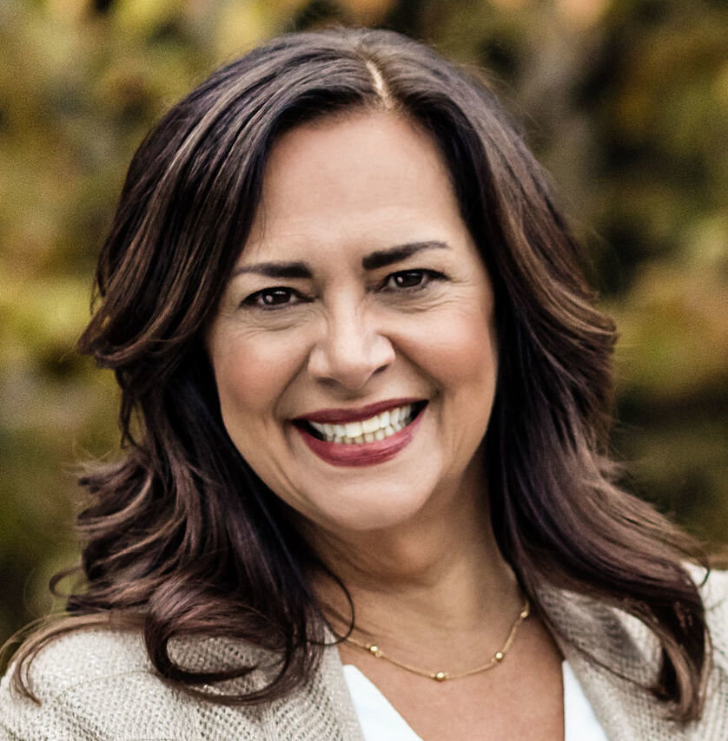
For more info:
Kathy Caprino, M.A.
kathycaprino.com
findingbrave.org
Mostpowerfulyou.com
Amazingcareerproject.com
email:
info@kathycaprino.com
@kathycaprino on: LinkedIn, Insta, Twitter
FB: @ElliaCommunications
www.amazingcareerproject.com
Boos Your Career

Slide 38
QUESTIONS?
Close Your Power Gaps and Rise • Kathy Caprino

